Slide 1
STEP
Exploring Runaway Electron mitigation systems in the STEP Tokamak
Lars Henden

Slide 2
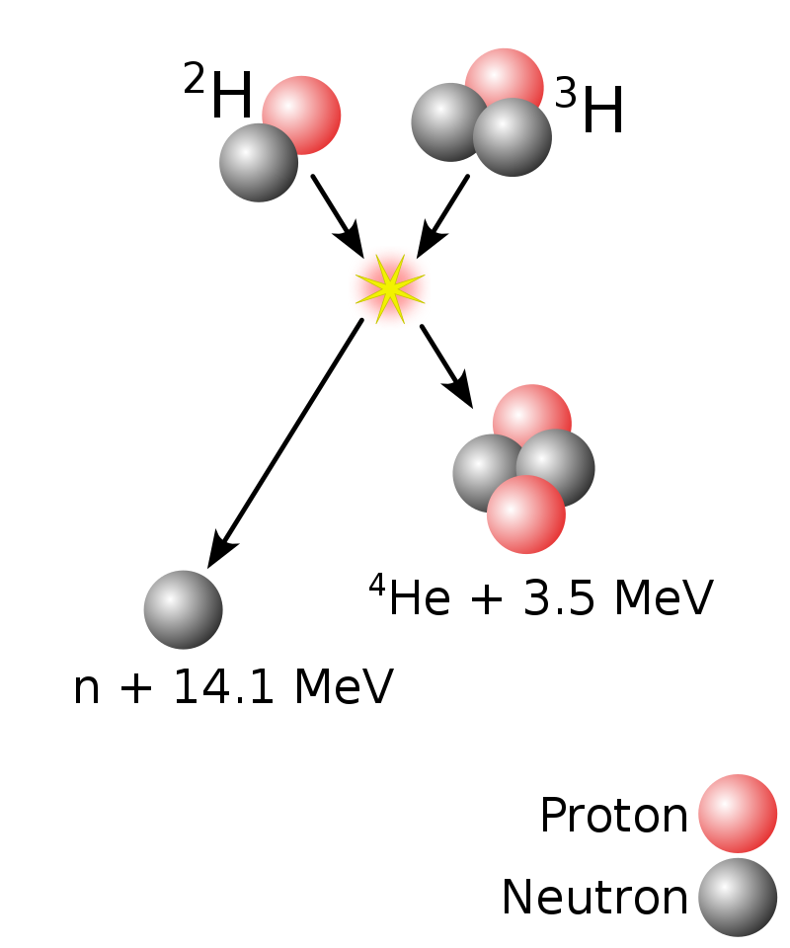
Theory background: Fusion
Nuclear reaction of Deuterium and Tritium to form Helium and a Neutron
A LOT of energy required to overcome the electrostatic repulsion of the protons in the two nuclei
Triple Product – An estimation of the required parameters for successful fusion
Density → 10¹⁹ – 10²⁰ m⁻³
Temperature → 10-20keV (110-230 million degrees)
Confinement Time → ~ 4 seconds
$$nTτ_{E}=3×{10}^{21} keV.s.m^{−3}$$

Slide 3
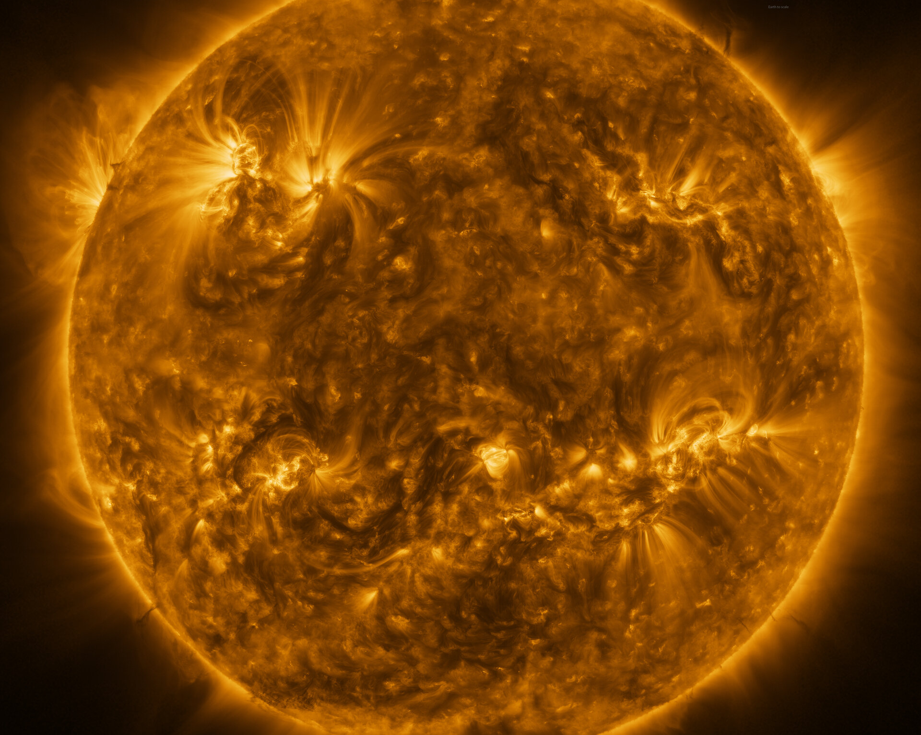
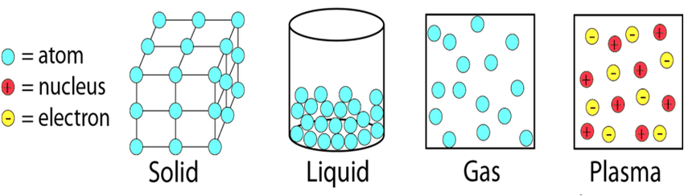
Theory background: Plasma
At temperatures in the keV’s, all the atoms will be fully Ionized
Forming the 4th fundamental state of matter – PLASMA
Collection of ionised negative electrons and positive nuclei
Need a device to create, maintain and utilise a plasma for fusion
Essentially a device to contain a mini-Sun
But it will have to be minimum 7x hotter

Slide 4
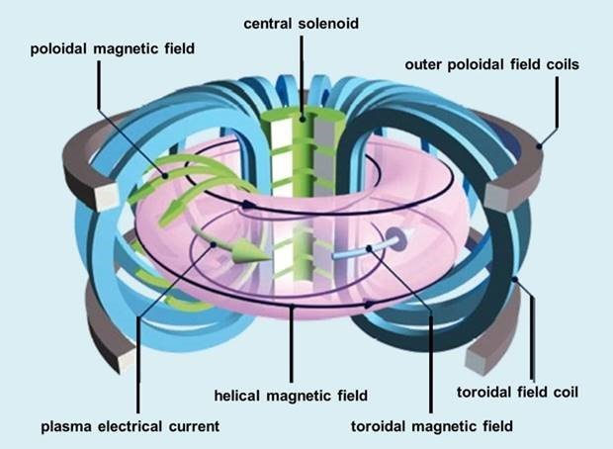
Theory Background: Tokamak
Enter, The TOKAMAK
Tokamaks utilise the fact that the a plasma contains ionised charged particles which interact with magnetic fields.
Using Toroidal and Poloidal magnetic field coils, a plasma can be “Magnetically Confined” into the shape of a torus (Donut)

Slide 5
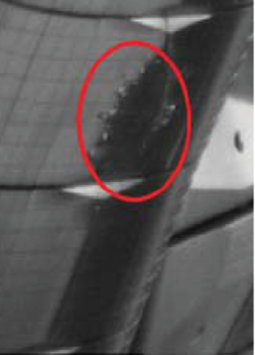
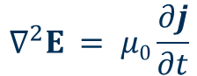
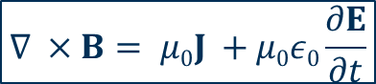
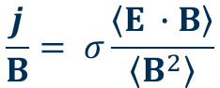
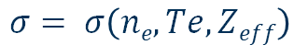
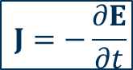

More Theory … Disruptions
Disruption – an event where the tokamak plasma experiences a rapid loss of thermal and magnetic energy due to MHD (MagnetoHydroDynamics) instabilities. Following a disruption:
Thermal loads
Electrical currents induced
Magnetic forces generated
Runaway Electrons (RE) formed
{
Can cause serious damage to Tokamak
$$J= σE$$
$$σ= σ\left(ne,Te,Zeff\right)$$
$$∇ ×B= μ0J +μ0ε0\frac{∂E}{∂t}$$
$$\frac{j}{B}= σ\frac{\left\langle E ∙B\right\rangle }{\left\langle B^{2}\right\rangle }$$
$$J=−\frac{∂E}{∂t}$$
Disruptions are a major threat to the continuous operation of a tokamak
Need a DMS (Disruption Mitigation System)
My project was to find a sufficient DMS for STEP focussing on RE mitigation
$$∇^{2}E = μ0\frac{∂j}{∂t}$$
MHD “ The study of the Magnetic properties and behaviour of Electrically conducting fluids”
JET RE beam internal wall (0.3MA)

Slide 6

Employer
UKAEA
United Kingdom Atomic Energy Authority
“UKAEA is an executive non-departmental public body, sponsored by the Department for Energy Security and Net Zero.”
Based at the Culham Science Centre
Founded in 1965 to be the home of UK Fusion research
Mission Statement:
"To lead the delivery of sustainable fusion energy and maximise the scientific and economic benefit."

Slide 7
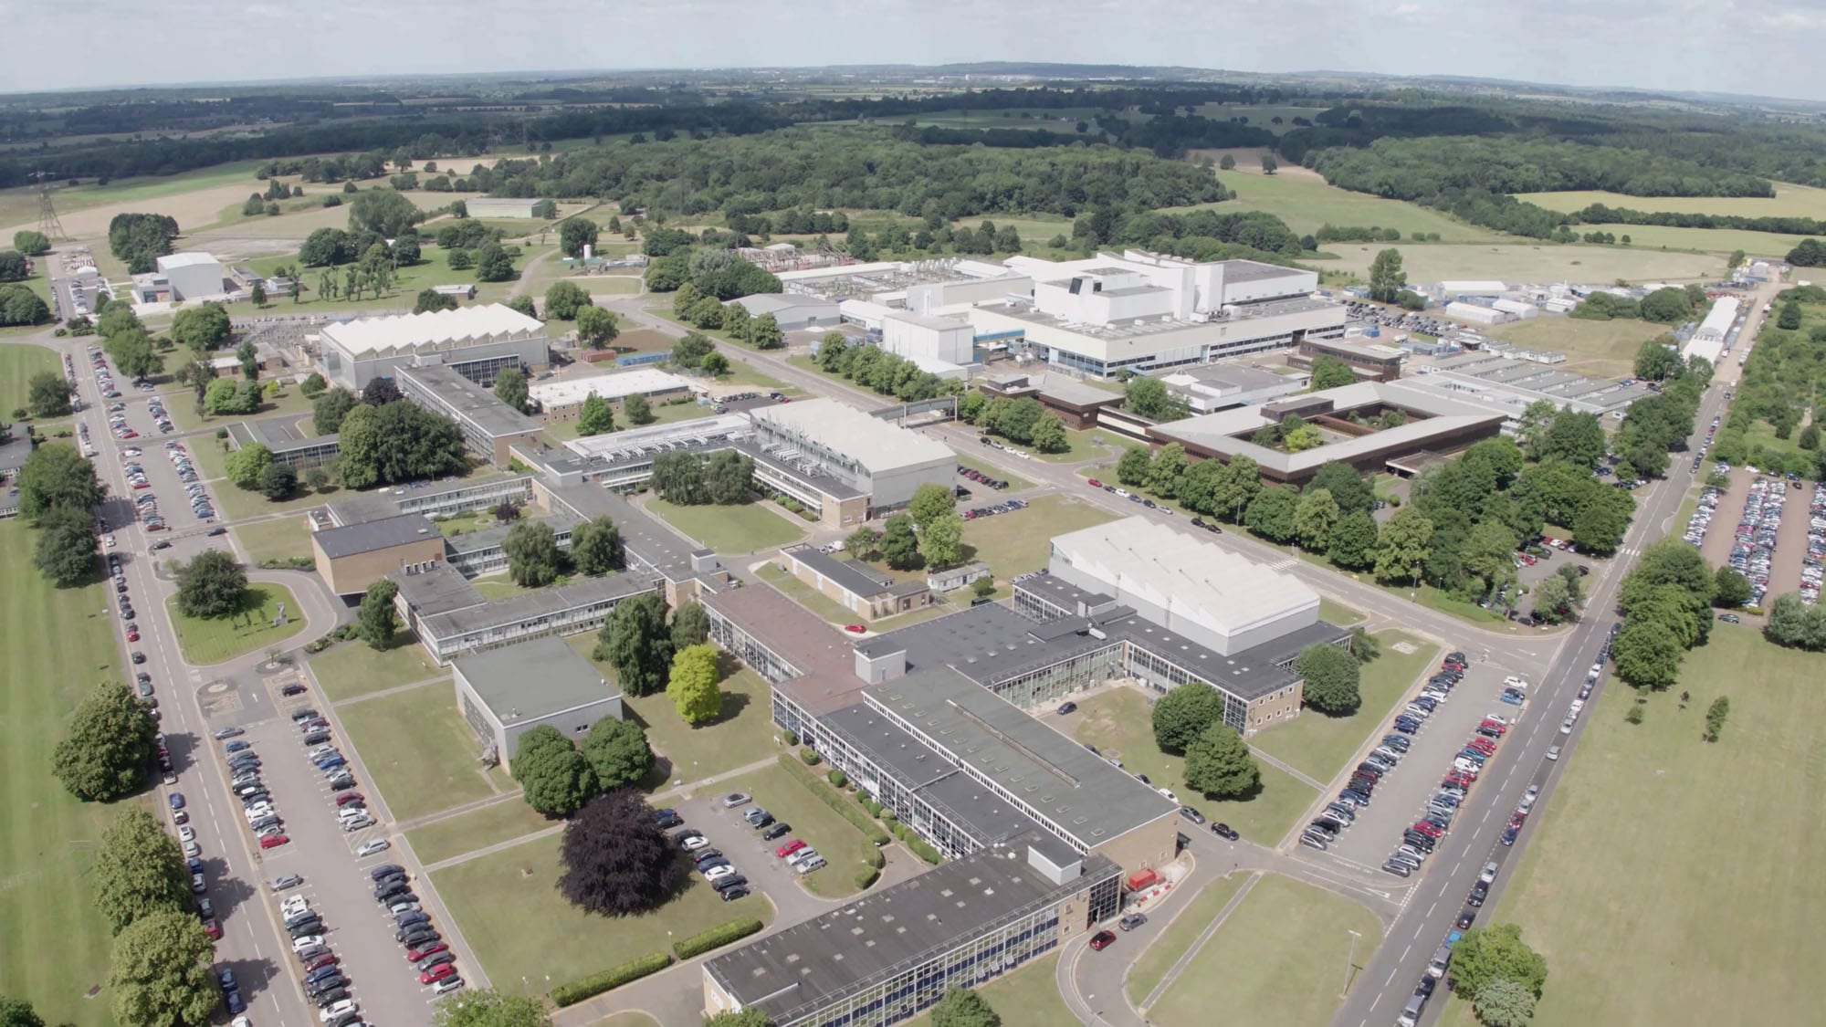
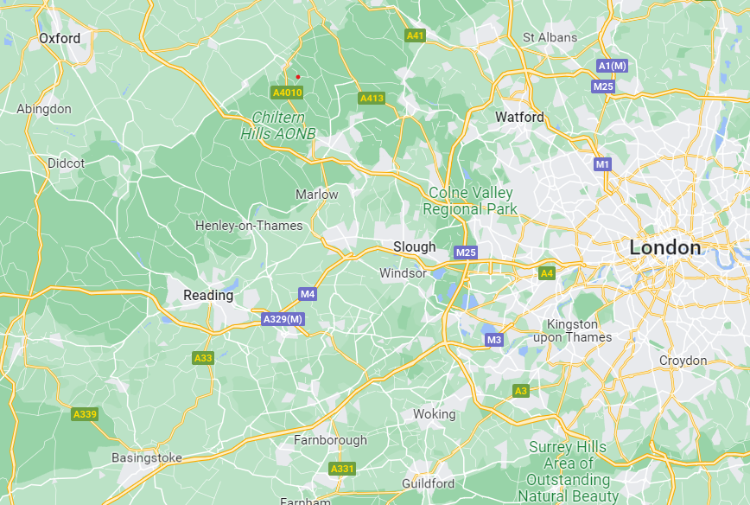
Where?
JET
UKAEA
My office
MAST-U
UofS

Slide 8
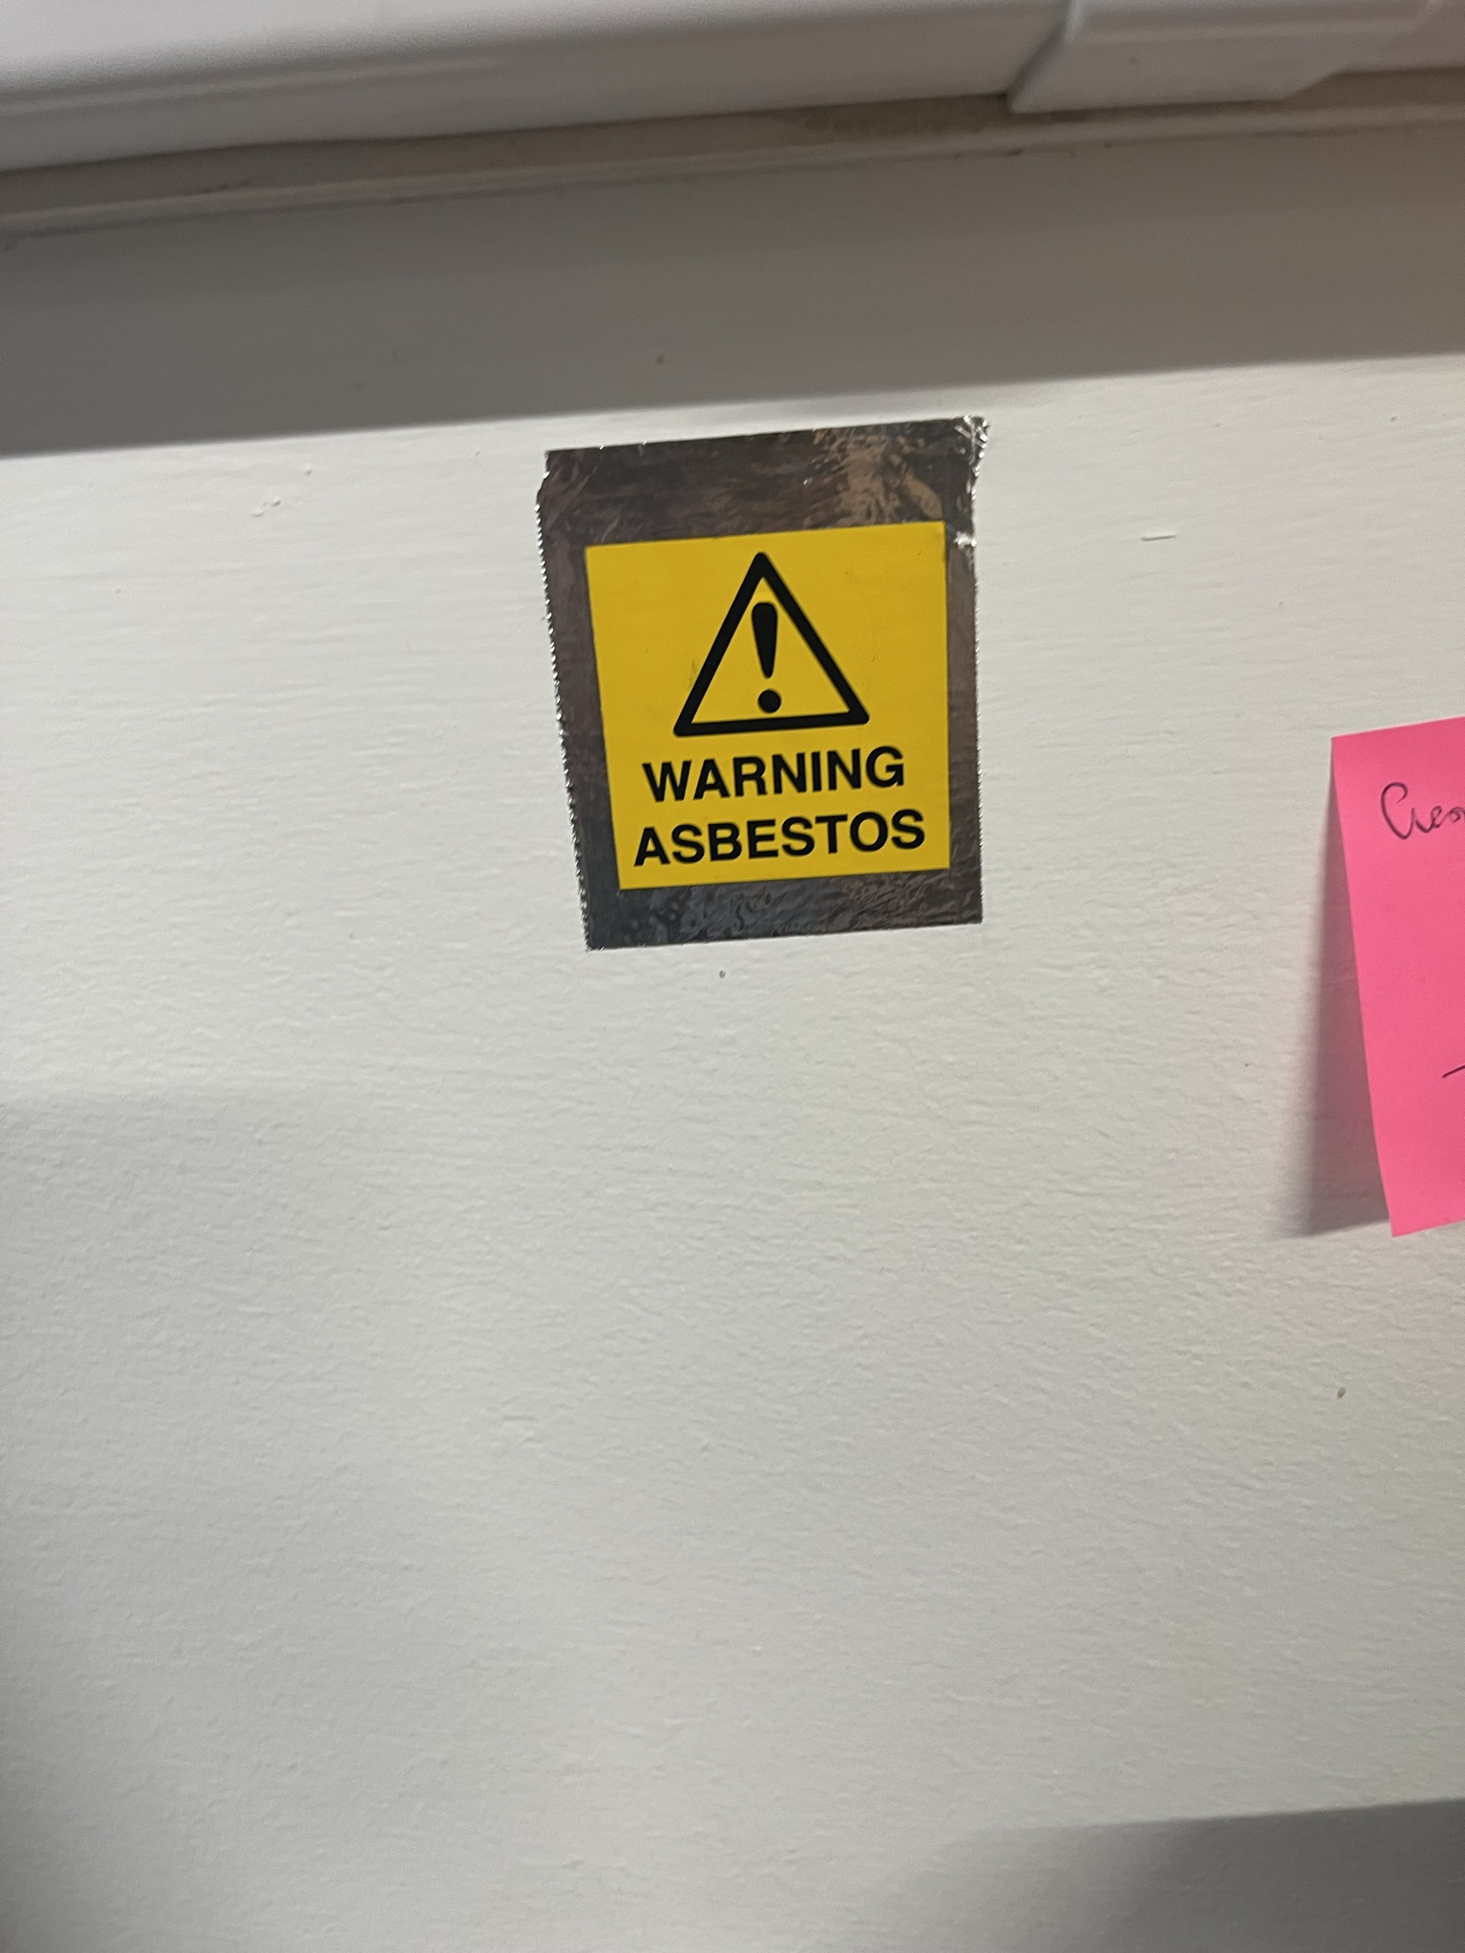
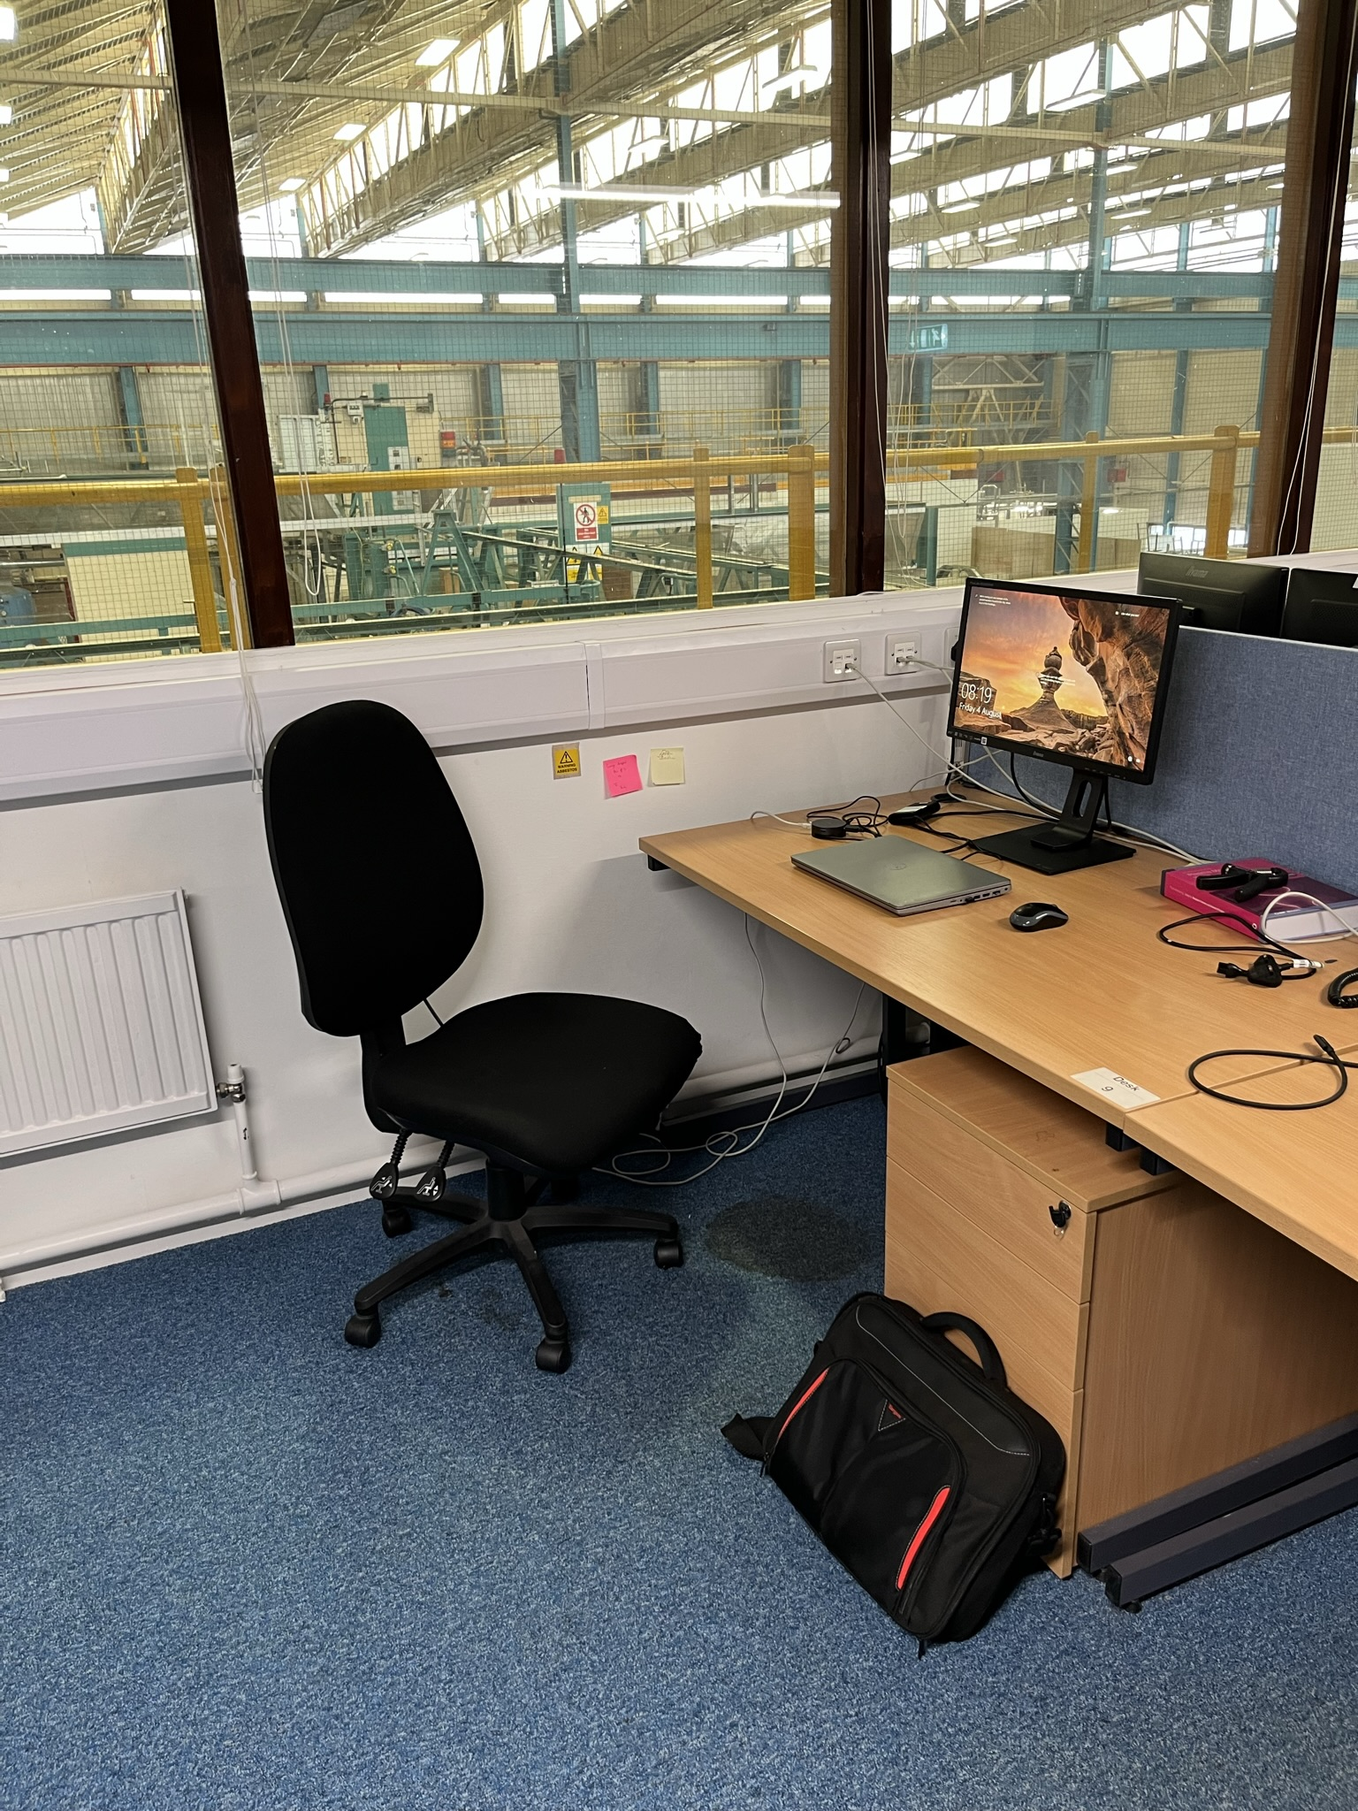
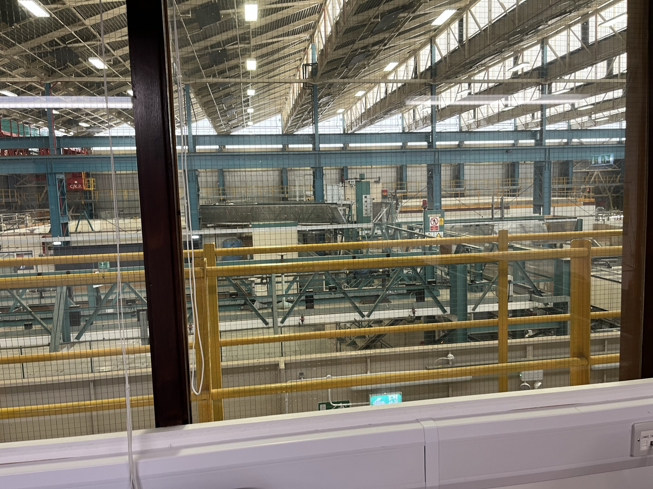
My office
Top of MAST-U
My workspace
MAST-U assembly hall

Slide 9
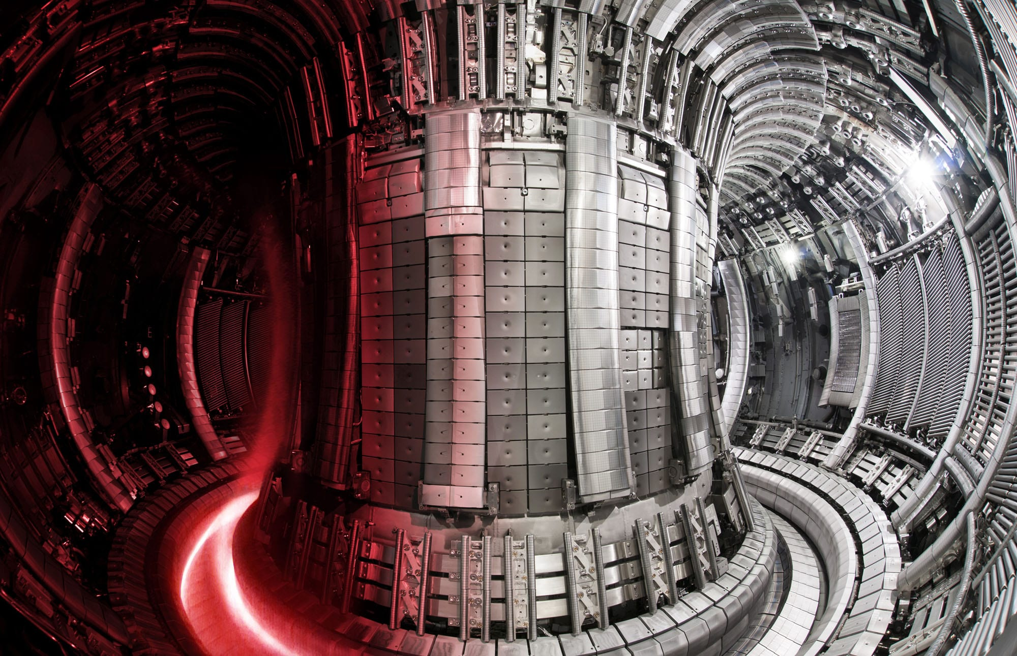
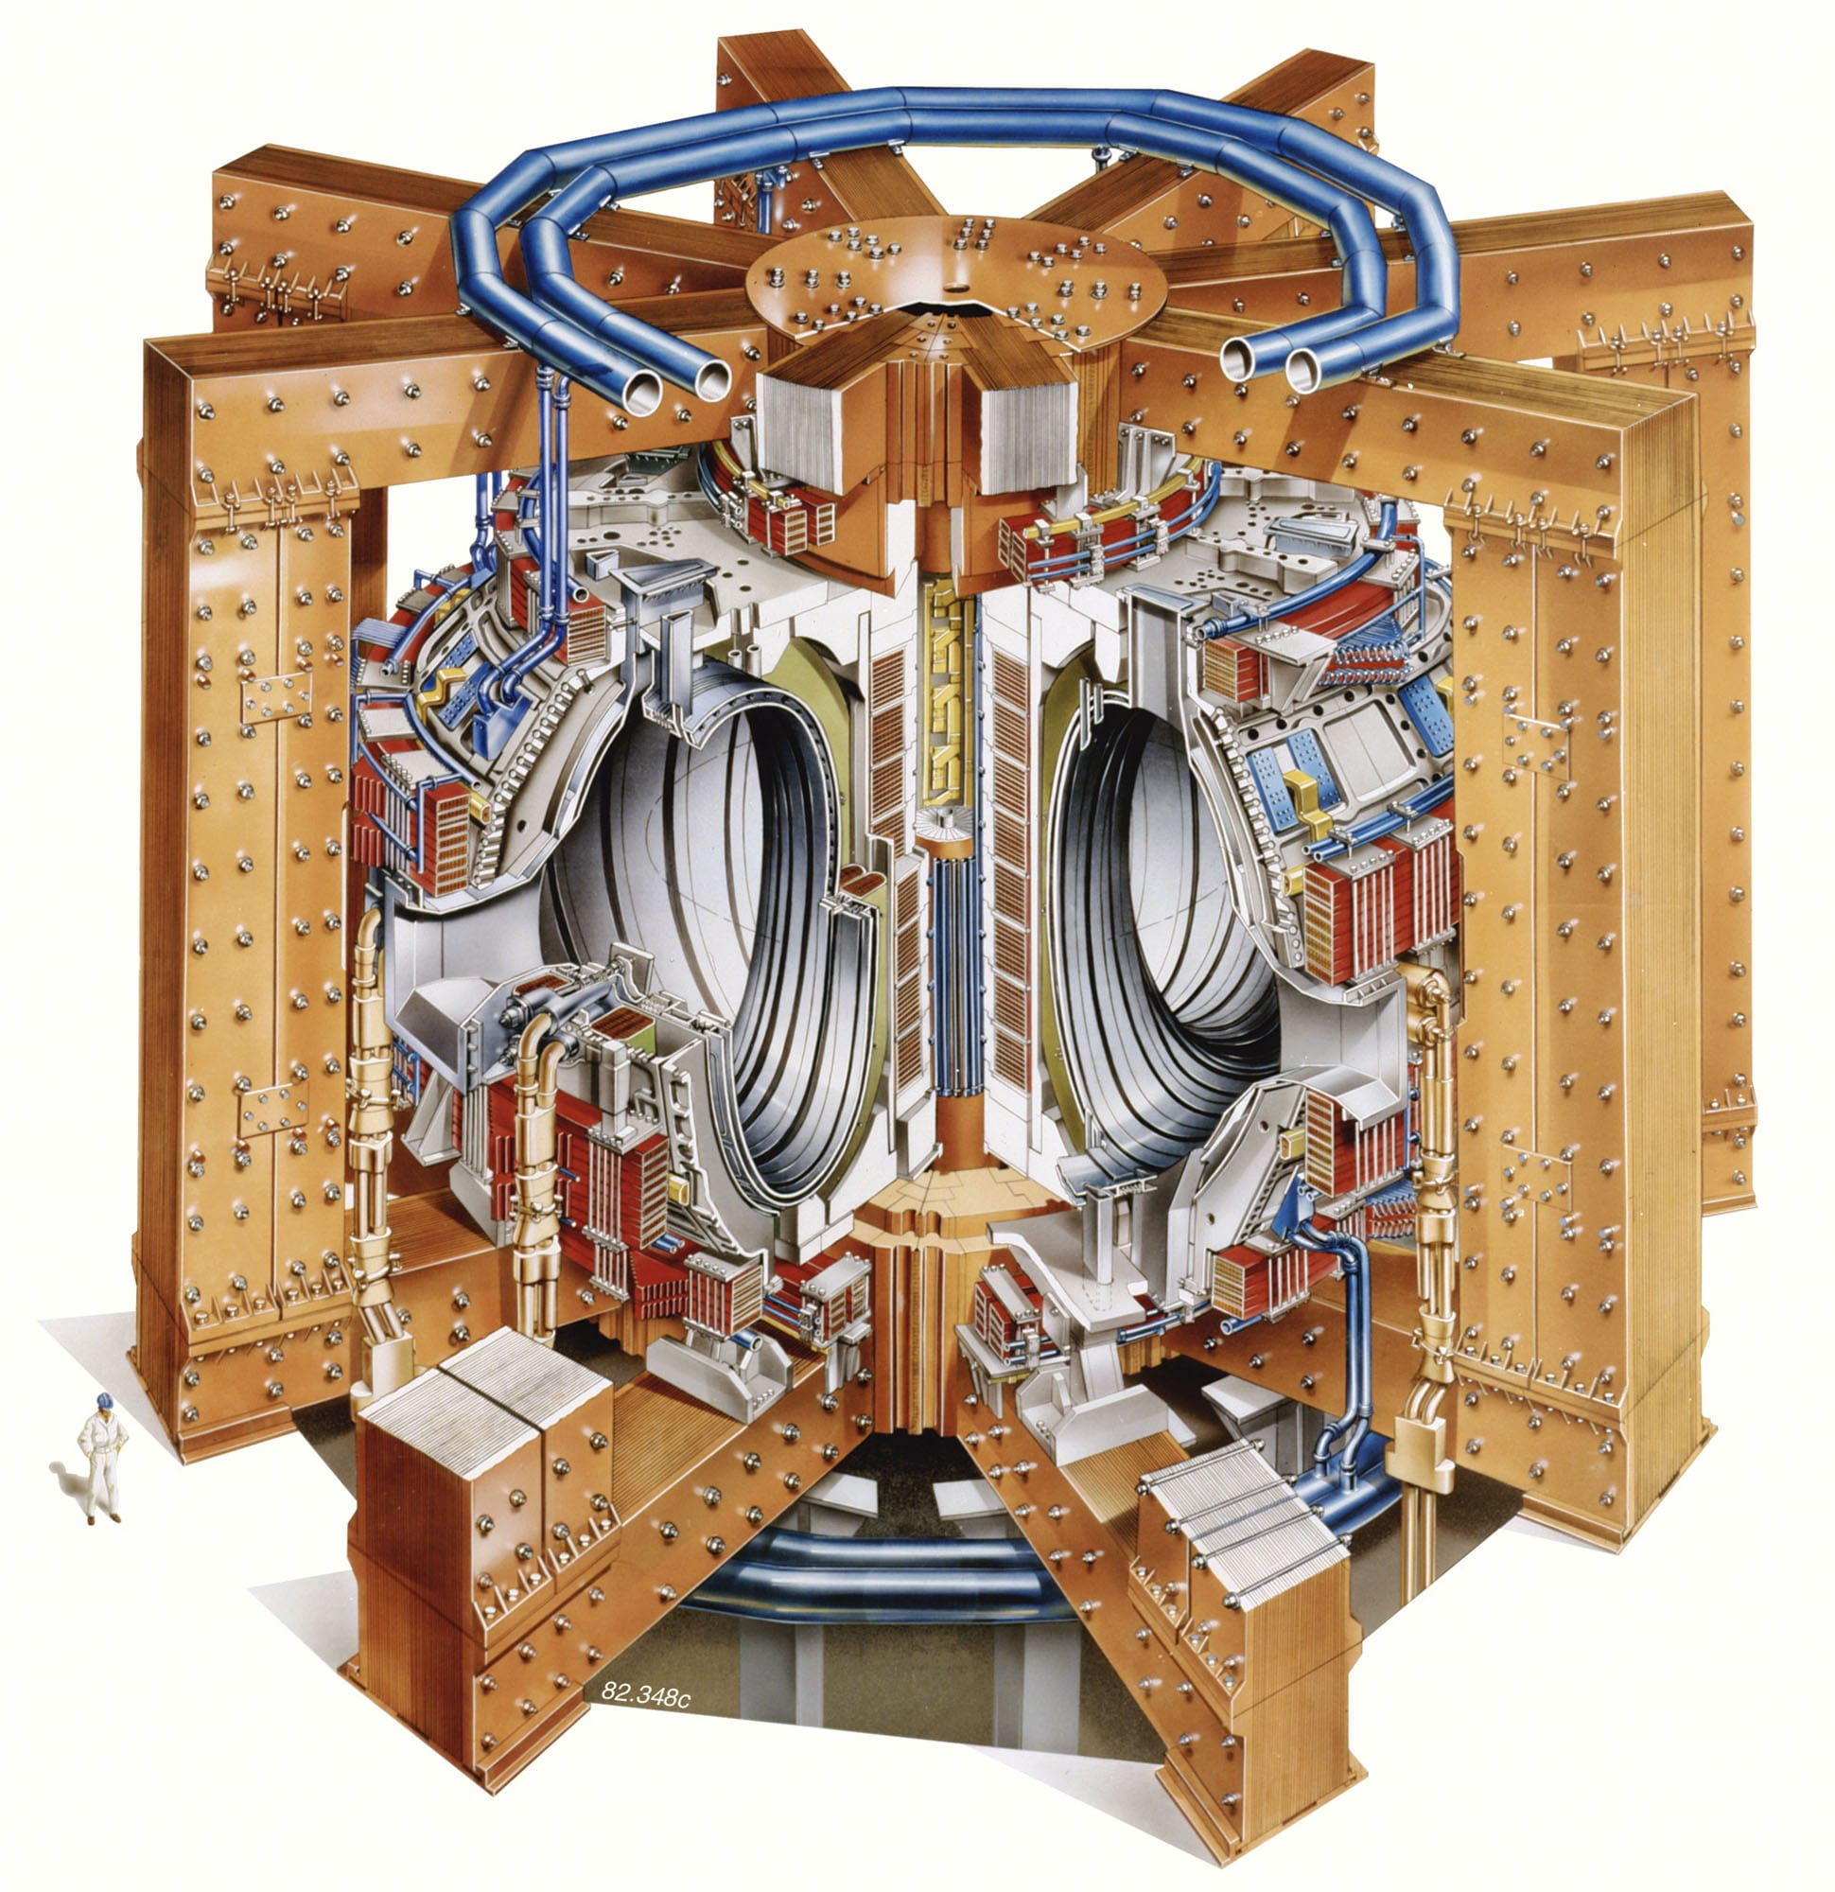

What do they do : JET
The principal achievement of UKAEA is JET, the Joint European Torus
Opened in 1983
Largest currently operating tokamak
Operate with a Deuterium-Tritium fuel mixture
Extensively upgraded and overhauled over its almost 40 year life span
Dec 2021 – 59MJ over 5s (Q_{plasma} =0.33)
Q_{plasma} - Fusion energy gain factor
$$Q_{plasma}= \frac{P_{Fusion}}{P_{Heating}}$$

Slide 10
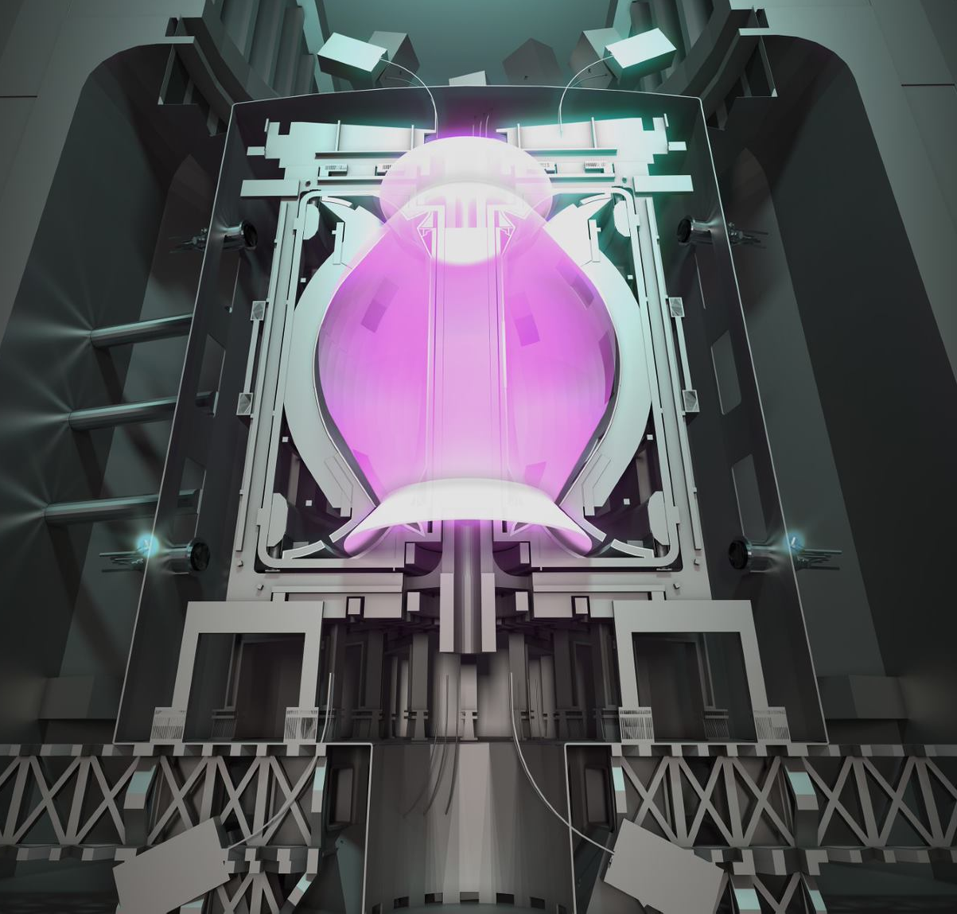
What they do: STEP
Spherical Tokamak for Energy Production
Design, develop and build the first prototype tokamak power plant aiming to produce energy
Completion: 2040
UK based at West Burton, Nottinghamshire

Slide 11
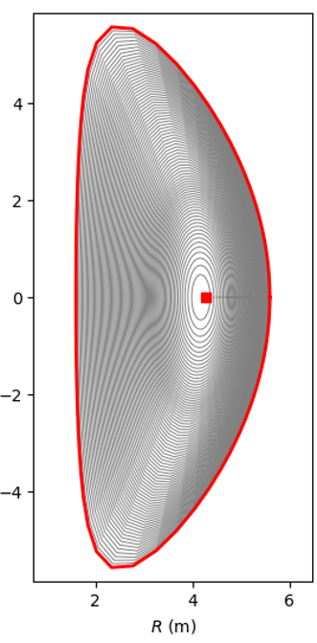
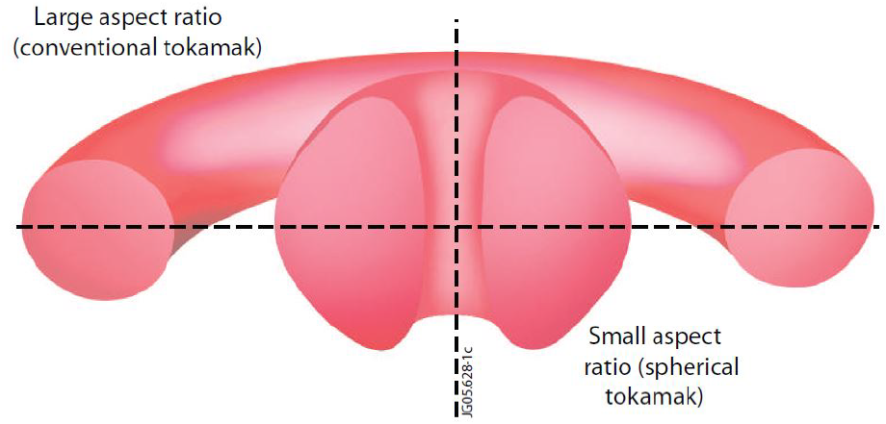
STEP details
Prototype power plant
Demonstrate Q_{electric} > 1 possible
Compact + affordable design
Commercially viable energy solution
Currently In Phase 1:
“Produce concept design”
High current (~20MA)
JET up to 5MA
Spherical tokamak
STEP-like plasma cross-section

Slide 12

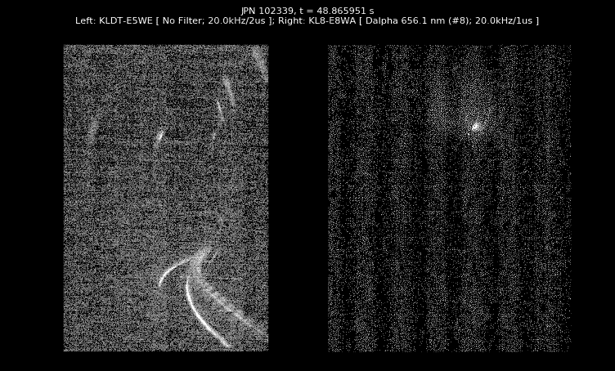
My Research, DREAM and CSD3
The core of my research was focused at simulating mitigation systems in a STEP-like plasma:
Idealized Impurity Injection (III)
Runaway Electron Mitigation Coil (REMC)
Shattered Pellet Injection (SPI)
Used the novel but advanced DREAM code
Disruption and Runaway Electron Analysis Model
I used the Cambridge Service for Data-Driven Discovery (CSD3) high performance computing cluster to run the DREAM code
SPI injection in JET video length = 5ms
Open-source code available: https://github.com/chalmersplasmatheory/DREAM

Slide 13
Achievements
Idealized Impurity Injection Scan
Ran extensive scan of mitigation system
Influenced DMS decision making for STEP
49th IOP Plasma Physics Conference Poster
End of March 2023 in Oxford
Shattered Pellet Injection scan
Reworked DREAM input files to run SPI
Made a cool animation
195 simulation scan over parameter space to assess viability of SPI
STEP RE mitigation Paper
To be published in the peer reviewed IAEA Nuclear Fusion Journal 2024

Slide 14
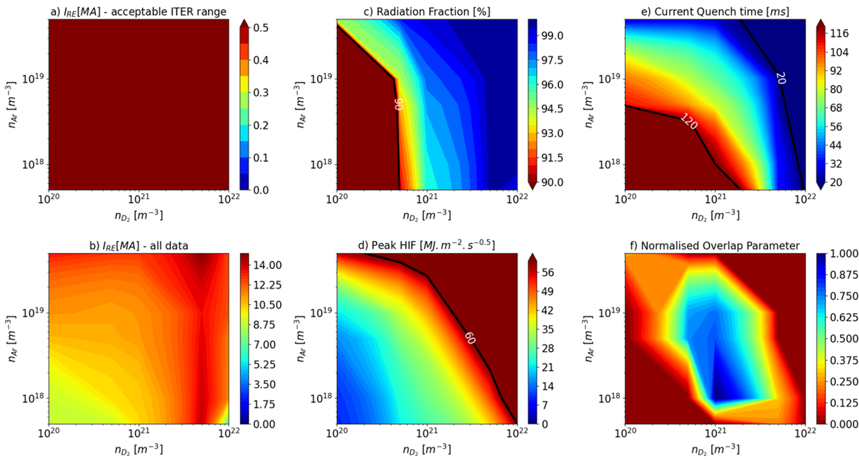
Idealized Impurity Injection Scan
Ran multiple simulations to scan over given parameters to find an operating window to satisfy DMS criteria
Ar+D₂ or Ne+D₂
Impurity densities - n_{imp} = 10¹⁷ - 10²² m⁻³
DMS constraints
I_{RE} < 0.5 MA
𝑓_{𝑟𝑎𝑑} > 90%
20 ≤ t_{CQ} ≤ 120 ms
HIF_{peak} < 60 MJ.m².s^{-0.5}
HIF = ‘Heat Impact Factor’
Normalised Overlap Parameter
Parameter which displays most viable window of operation for given DMS constraint values
Provides multi-simulation, overall DMS proficiency analysis & assessment

Slide 15
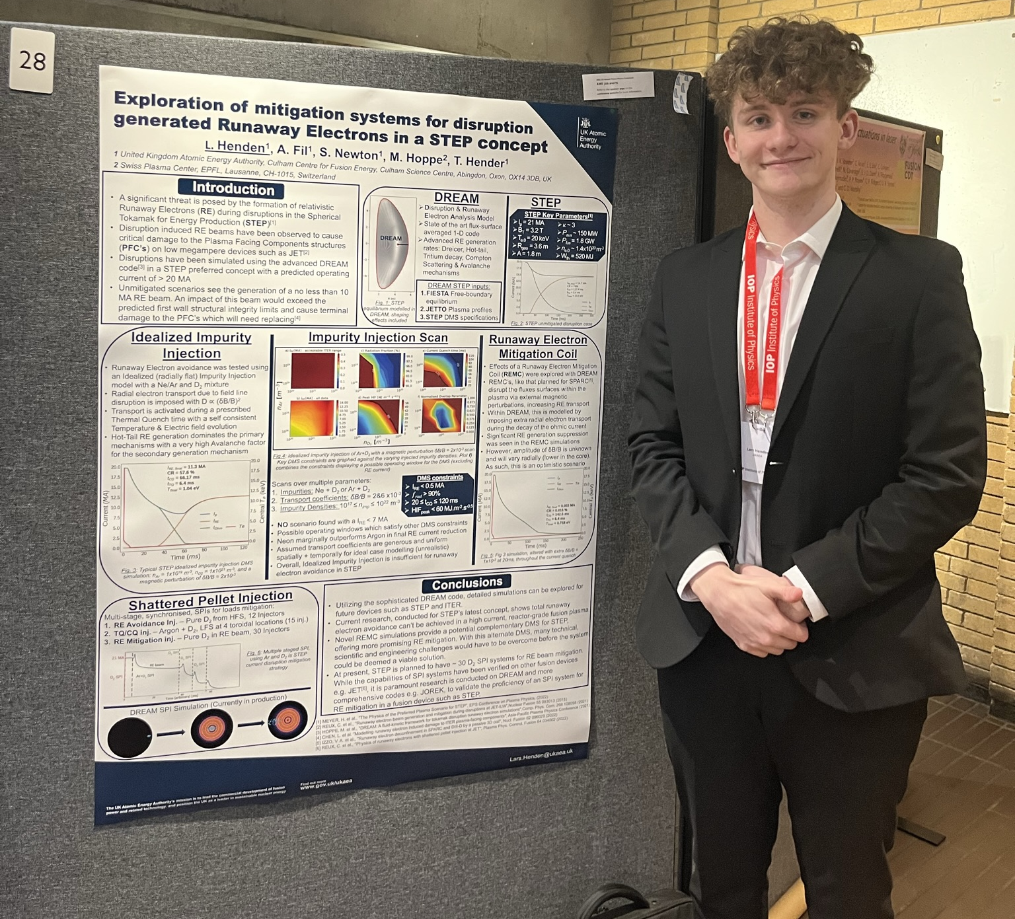
49th IOP Plasma Physics Conference

Slide 16
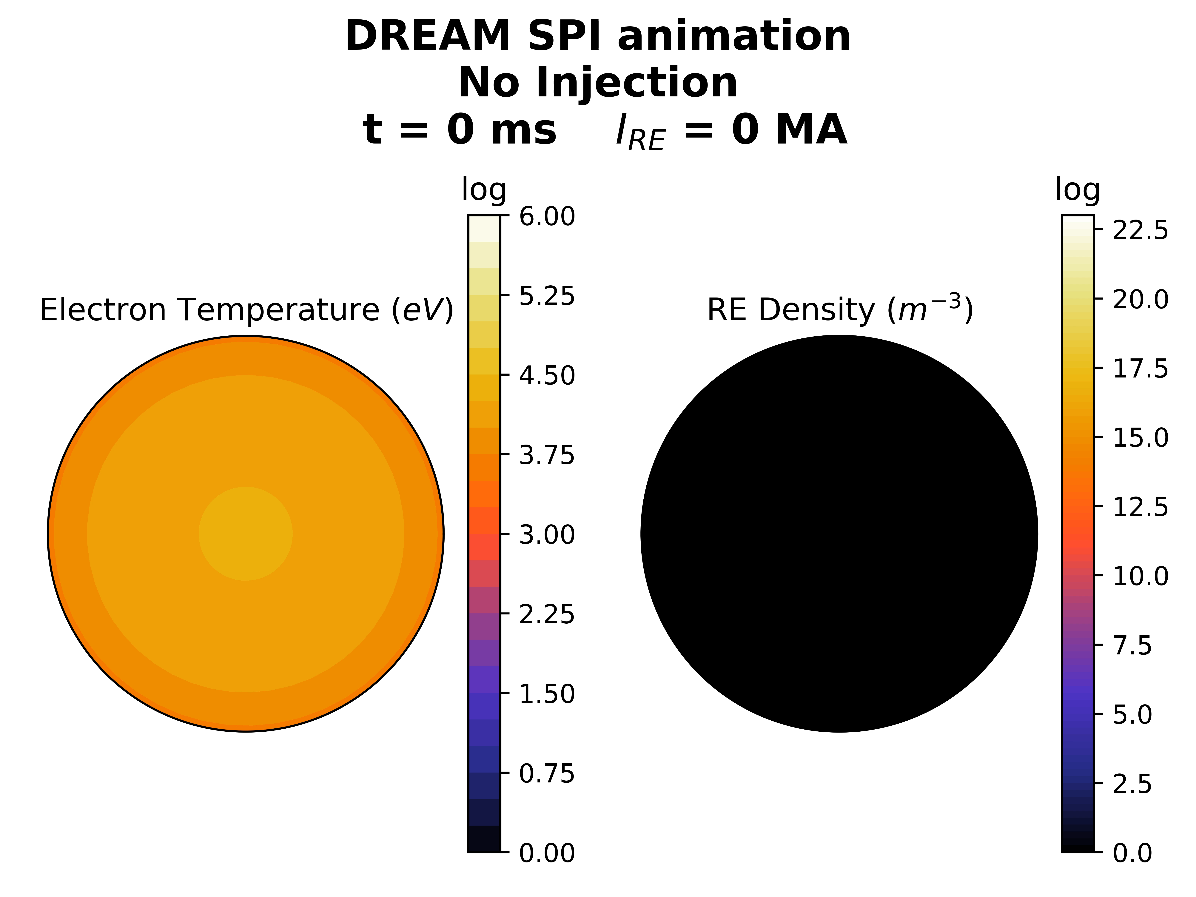
No Injection
Initialisation
First SPI
Pure Deuterium
Second SPI
Argon & Deuterium
CQ & Runaway plateau
Typical SPI animation
Cylindrical geometry plasma
2 stage SPI injection
Electron temp + RE density

Slide 17
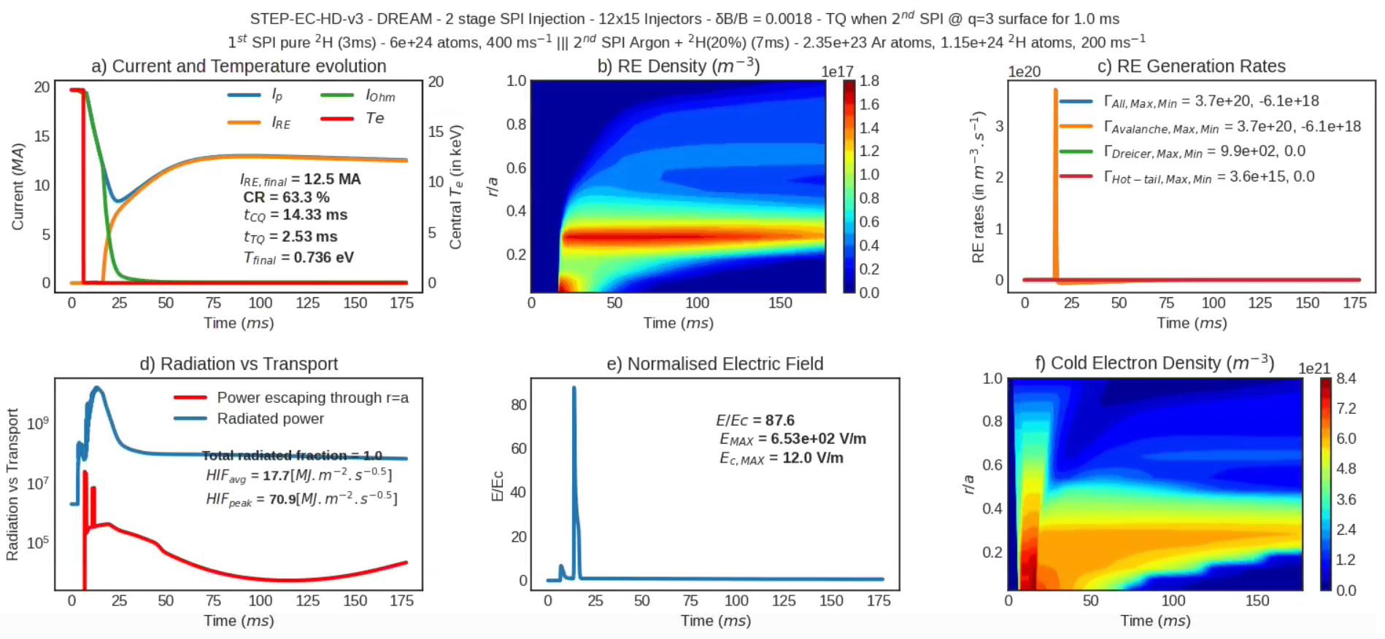
Typical SPI Simulation

Slide 18
Other Achievements
REMC simulations:
Suggested the possibility of a REMC for STEP, led to my research as well as a discussion within the STEP team about REMC
Reworked the DREAM input files to simulate the effects of a REMC
Played an active role in demonstrating its usability as a DMS
Schools and Courses
Oxford University MMathPhys Collisional Plasma Physics Course
Princeton Plasma Physics Laboratory Introduction to Fusion Summer School
Culham Centre for Fusion Energy Plasma Physics Summer School

Slide 19
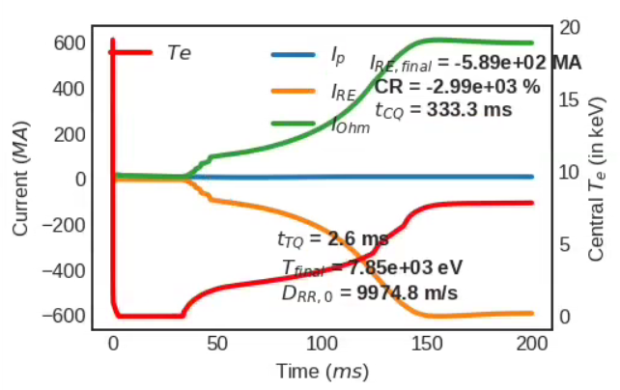
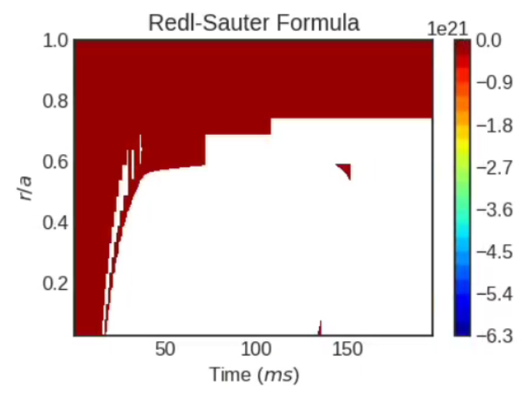
Problems and tackling them
CODING.
DREAM builder files error
First week
Novel system – Linux
Error compiling the code
Blow-up simulations
Non-physical output
Data analysis
Error solving
Currents in blow-up simulation
Normal range:
0-20MA
Conductivity plotted against time & normalised radius
Analytical formula:
‘Redl-Sauter’
Conductivity is a function of:
Electron Collisionality

Slide 20





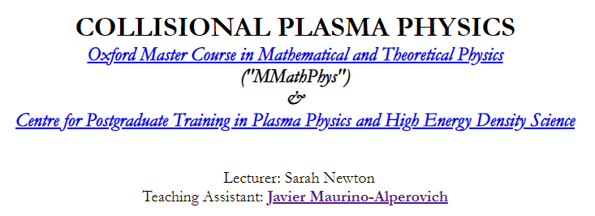
Personal Growth
Developed Coding & Simulation skills
Languages – Python (Pandas, h5py, matplotlib)
Scientific codes – DREAM
LaTeX typesetting & Git
Invaluable skill for placement and future
Wealth of Plasma & Fusion knowledge
Personal reading
Summer schools
Conference
University course
Individual discussions

Slide 21
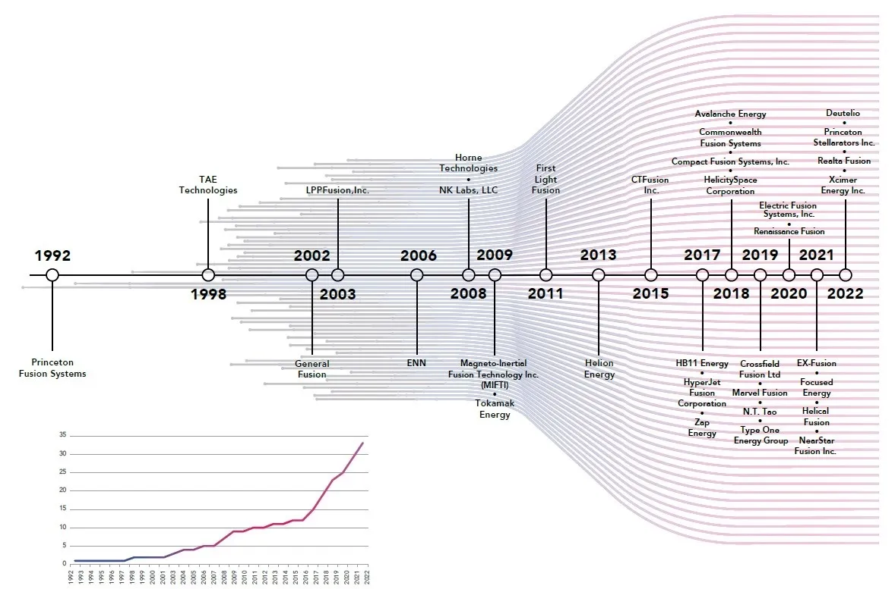

Has my placement been useful?
Changed my future prospects
Developed an inspiration for fusion
Discovered an personal interest with research and coding
Affirmed my decision to pursue post-graduate opportunities
Creation of private fusion companies by year
Appreciation of physics oriented work culture
Understand how physics can fit into my career
Broader view on where physics can be applied
Helion Energy

Slide 22
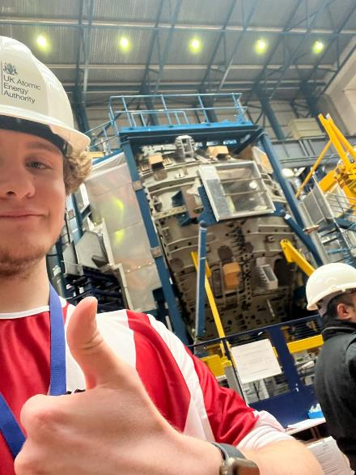
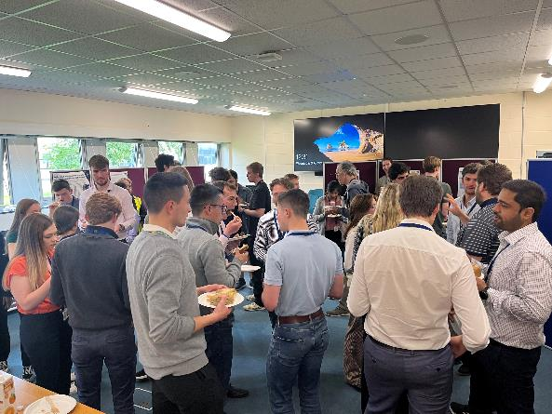
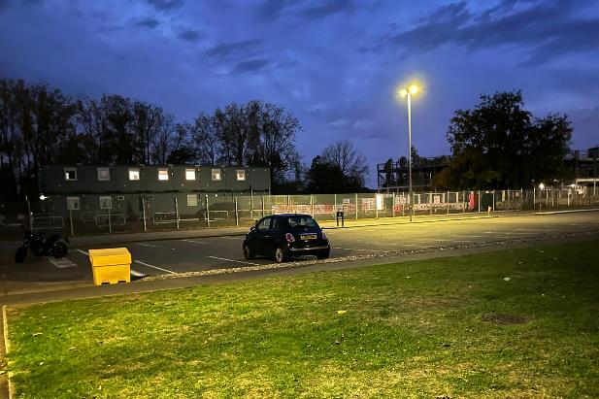
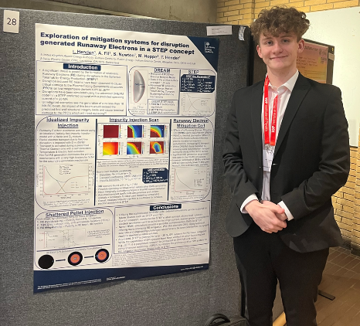
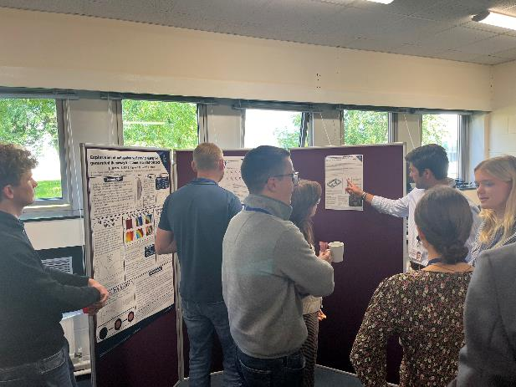
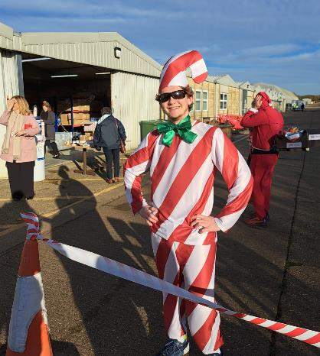
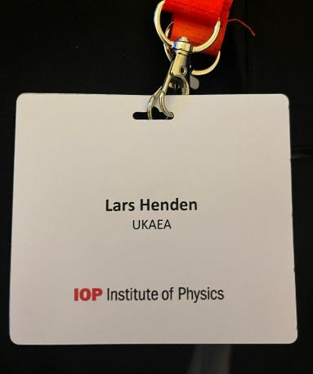

Thank you for Listening!

